Slide 1
HPCA 2022-Sessions¹
Power
Hardware⁴
Accelerator
HPCA 2022
Memory
Specific Applications
Network
Matrix²
Graph and NNs³
Rest of the papers on accelerator
1. Sessions on security, quantum, simulation, and synthesis are not included. Some papers that are not accessible online are not included.
2. Topics include dense and sparse matrices; vectors and tensors are seen as matrices.
3. Topics on matrix are excluded.
4. Software methods are mostly used to improve the performance of hardware.

Slide 2
HPCA 2022 – Accelerator Session
Accelerator
HPCA 2022
Hardware
Matrix
Rest of the papers on accelerator
Specific Applications
Graph and NNs
Propose an architecture that pack multiple time points into a single time window (TW) and process the computations falling under several TWs in parallel, which allows weight reuse across multiple time points and reduces idling of processing elements in Spiking Neural Networks (SNNs, temporal dynamics and event-driven processing) [A.1].
LISA: a portable compilation framework that automatically identifies the impact of dataﬂow graph (DFG) structure characteristics (representing an application) and generates quality mapping for varied spatial accelerators [A.2].
GCoD: a Graph Convolutional Networks (GCN) algorithm and accelerator Co-Design framework that polarizes the graphs to be either denser or sparser in local neighborhoods and uses separated engines in accelerator to process each, which alleviate GCN irregularity and boost GCNs’ inference efﬁciency [A.3].
MAGMA: an optimization algorithm with custom operators that focus on mapping jobs from several DNNs simultaneously on an accelerator and enable structured sample-efﬁcient exploration [A.4].
FAST: a Fast First, Accurate Second Training (FAST) system for DNNs that presents weights, activations, and gradients in Block Floating Point (BFP, provide an arithmetic approaching floating point while using a fixed-point processor) and supports matrix multiplication with variable precision BFP input operands, which enable incremental increases in DNN precision throughout training [A.5]
[A.1] https://web.ece.ucsb.edu/~lip/publications/SparseSNNAccelerationIEEE-MICRO-Submitted2021.pdf
[A.2] https://www.comp.nus.edu.sg/~tulika/HPCA_LISA_2022.pdf
[A.3] https://arxiv.org/abs/2112.11594
[A.4] https://arxiv.org/abs/2104.13997
[A.5] https://arxiv.org/abs/2110.15456

Slide 3
HPCA 2022 – Accelerator
Accelerator
HPCA 2022
Hardware
Rest of the papers on accelerator
Specific Applications
Graph and NNs
Matrix
Present the structure of a bit-serial matrix multiplier for large, sparse, static matrices in reservoir computing systems, which allows for significant reduction in latency and power through constant propagation and logic minimization [A.6].
uSystolic: a hybrid unary-binary systolic array that inherits the legacy-binary data scheduling with power-efﬁcient data movement for general matrix multiply (GEMM) in DNN [A.7].
S2TA: a systolic array-based CNN accelerator for mobile devices, which exploits joint weight and activation Density Bound Block (DBB) sparsity and new dimensions of data reuse [A.8].
Griffin: a hybrid architect that reuses resources of the same core to maintain high performance and power efﬁciency when running single sparsity (with only sparse weight or sparse activation tensors) or dense models [A.9].
CANDLES: a microarchitecture and dataﬂow that adopts a Pixel-ﬁrst compresssion and Channel-ﬁrst dataﬂow, which reconciles the energy expenditure trade-offs between Pixel-ﬁrst or Channel-ﬁrst sparse accelerators and promotes high temporal locality in neuron updates and lower energy [A.10].
[A.6] https://arxiv.org/abs/2101.08884
[A.7] https://diwu1990.github.io/files/2022-02-12-hpca-paper.pdf
[A.8] https://arxiv.org/abs/2107.07983
[A.9] https://arxiv.org/abs/2107.12922
[A.10] https://www.cs.utah.edu/~rajeev/pubs/hpca22.pdf

Slide 4
HPCA 2022 – Accelerator Session
Accelerator
HPCA 2022
Hardware
Matrix
Graph and NNs
Specific Applications
Rest of the papers on accelerator
CAMA: a Content-Addressable Memory (CAM) enabled Automata accelerator for processing homogeneous non-deterministic ﬁnite automata (NFA) during advancing real-time analytic to avoid memory and energy wasted in running most real-world benchmarks [A.11].
Develop a near-data computing paradigm called near-stream computing, comprising a compiler, CPU ISA extension, and a microarchitecture that facilitate programmer transparent computation ofﬂoading to shared caches, which reduces bottlenecks of data movement and communication in large multicore systems [A.12].
Propose a software (identifying atomic updates) – hardware (extending the reconﬁgurable local SRAM per SM) co-design for GPU applications that use atomics to update shared global variables [A.13].
Subwarp interleaving: an architectural enhancement that exploits thread divergence to hide pipeline stalls in divergent sections of low warp occupancy workloads, which increases hardware utilization and reduces warp latency [A.14].
[A.11] https://arxiv.org/abs/2112.00267
[A.12] https://seanzw.github.io/pub/hpca2022-near-stream-computing.pdf
[A.13] https://wu-kan.cn/2022/03/16/Only-Buffer-When-You-Need-To-Reducing-On-chip-GPU-Traffic-with-Reconfigurable-Local-Atomic-Buffers/
[A.14] https://research.nvidia.com/publication/2022-01_GPU-Subwarp-Interleaving

Slide 5
HPCA 2022 – Hardware Session-Memory
Power
Hardware
Accelerator
HPCA 2022
Memory
Specific Applications
Network
COARSE: a disaggregated memory extension for parameter communication in distributed DL training [M.1].
Propose Generate-Load-Apply (GLA) execution model to use a concept of chain to characterize the overlapped feature of a hypergraph, reuse data in existing hypergraph systems; present ChGraph, the first hardware-accelerated hypergraph processing engine near each core, which is responsible to accelerate the chain generation on the fly and the chain-guided data loading (to hide memory access latency), while the general-purpose cores are responsible only for handling the apply operations of GLA [M.2].
Identify the inefﬁciencies of a Propagation Blocking (PB, a software-based cache locality optimization initially designed for graph processing applications) execution on conventional multicore processors and propose architecture to improve PB performance and reduce inefﬁcient use of conventional cache hierarchies [M.3].
Present a cache replacement policy that is based on multiclass prediction that learns each cache line’s reuse distance and then evicts lines based on their predicted time of reuse [M.4].
Propose cache-level prediction to complement prefetchers which predicts which memory hierarchy level a load will access and allows the memory loads to start earlier and save many cycles [M.5].
[M.1] https://cseweb.ucsd.edu/~jzhao/files/wang-hpca2022.pdf
[M.2] https://qgwang-hust.github.io/files/ChGraph-HPCA'22.pdf
[M.3] https://bvignesh.github.io/papers/COBRA-HPCA22.pdf
[M.4] https://www.cs.utexas.edu/~lin/papers/hpca22.pdf
[M.5] https://arxiv.org/abs/2103.14808

Slide 6
HPCA 2022 – Hardware Session-Memory
Power
Hardware
Accelerator
HPCA 2022
Memory
Specific Applications
Network
TCOR: a memory hierarchy organization for mobile GPUs, which uses optimal page replacement (OPT) policy to enhance energy efficiency and hit rates [M.6].
MULTI-CLOCK: a low-overhead hybrid (persistent and CPU) memory system that relies on a page selection technique capturing both page access recency and frequency for data placement in the memory [M.7].
NVMExplorer: a cross-stack design space exploration framework to compare and evaluate future on-chip memory solutions with system constraints and application-level impacts in-the-loop [M.8].
PIMCloud: a QoS (Quality of Service)-aware resource manager designed for cloud systems with processing-in-memory (PIM) allowing colocation of multiple latency-critical applications [M.9].
Virtual Coset Coding (VCC): a workload-independent approach that uses coset encoding with random coset candidates and replaces a large number of coset candidates with small set of random substrings to reduce costly symbol transitions for storing encrypted data [M.10].
[M.6] https://upcommons.upc.edu/handle/2117/365470
[M.7] https://zenodo.org/record/5772990
[M.8] https://arxiv.org/abs/2109.01188
[M.9] http://people.ece.cornell.edu/martinez/doc/hpca22-pimcloud.pdf
[M.10] https://arxiv.org/abs/2112.01658

Slide 7
HPCA 2022 – Hardware Sessions-Power and Network
Power
ReTail: a systematic process to select the features of any given application that best correlate with its request latency, and use these features to predict latency and adjust CPU’s power consumption for request-level power management of latency-critical services with QoS constraints [P.1].
DarkGates: a hybrid architecture that increases the performance of maximum attainable frequency-constrained systems while fulfilling their power efficiency requirements to reduce the leakage power of inactive (dark) silicon components [P.2].
Hardware
Accelerator
HPCA 2022
Memory
Specific Applications
Network
FastTrackNoC: a Network-on-Chip router architecture that bypasses its switch traversal stage to reduces latency and adds a fast-track path between the head of a particular virtual channel buffer at each input port and the link of the opposite output [N.1].
Propose a deadlock recovery framework that detects a deadlock by discovering the upward packet and recovers the system by transmitting the upward packet to its destination [N.2].
Propose Delegated Replies that lets memory nodes speculatively delegate the responsibility of replying to last-level cache hits to the private cache and reduces network clogging [N.3].
[N.1] https://research.chalmers.se/publication/522726/file/522726_Fulltext.pdf
[N.2] http://www.ece.ualberta.ca/~jhan8/publications/47.pdf
[N.3] https://folk.idi.ntnu.no/jahre/papers/delegated-replies-hpca22-postprint.pdf
[P.1] https://www.csl.cornell.edu/~delimitrou/papers/2022.hpca.retail.pdf
[P.2] https://arxiv.org/abs/2112.11587

Slide 8
HPCA 2022 – Application Session
Accelerator
HPCA 2022
Hardware
Specific Applications
Hercules: an optimized framework for personalized recommendation inference serving that targets diverse industry-representative models and cloud-scale heterogeneous systems [AA.1].
RAR: Reliability-Aware Runahead (a technique that allows a microprocessor to pre-process instructions during cache miss cycles instead of stalling), renders microarchitecture state non-vulnerable during runahead execution and initiates runahead execution early to improve soft-error reliability [AA.2].
AVA: an Adaptable Vector Architecture that is designed for short vectors but provides high efﬁciency for applications featuring long vectors with high Data Level Parallelism to prevent wasting resources and underutilizing Vector Register File (VRF) [AA.3].
DR-STRaNGe: an end-to-end system design for DRAM-based True Random Number Generators (TRNGs) [AA.4]
[AA.1] https://arxiv.org/abs/2203.07424
[AA.2] https://ajnaithani.github.io/docs/hpca22.pdf
[AA.3] https://arxiv.org/abs/2111.05301
[AA.4] https://arxiv.org/abs/2201.01385

Slide 9
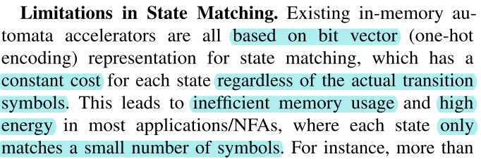
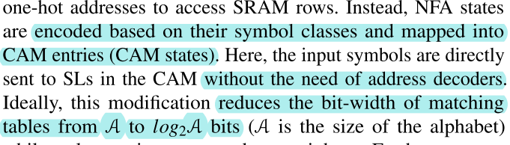
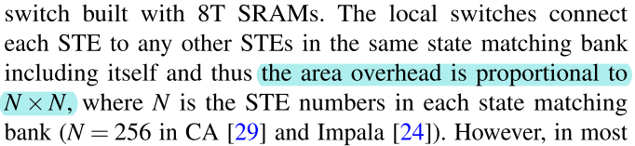
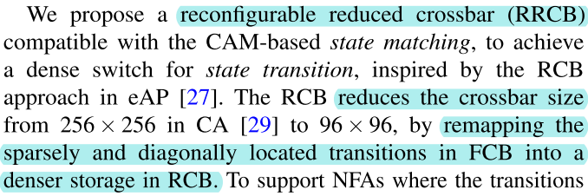

HPCA 2022: Energy and Memory Efﬁcient Automata Processing in Content-Addressable Memories ^{[A.3]}
I. Background
IV. Experiment and Results
Content Addressable Memory (CAM): suitable for ﬁxed-width bit string matching and extensively used in networking for IP lookup and packet classiﬁcation.
Compared to Deterministic Finite Automaton (DFA), the Non-deterministic FA (NFA) holds multiple active states at the same time and supports multiple transitions on a single input.
However, existing CAM-based methods cannot handle complex applications beyond packet inspection, because of the state explosion issues in converting an expressive NFA to a DFA .
Two versions of CAMA designs, one optimized for energy (CAMA-E) and the other for throughput (CAMA-T),
Use 21 common real-world and synthetic benchmarks.
Compared to state-of-the-art (SOTA) designs, CAMA-E achieves > 2×lower energy, while CAMA-T shows > 2.6× higher compute density.
“We propose CAMA, the ﬁrst CAM-enabled, low-area, and energy-efﬁcient automata processor for homogenous NFA in streaming processing, which replaces the bit vector representation in SOTA RAM-based designs by direct symbol matching in CAMs. “
II. Challenges
III. Solutions*
state matching
All existing in-memory automata processors execute an
automaton in two steps: state matching and state transition.
state transition
[A.3] https://arxiv.org/abs/2112.00267
* In addition to the major methods introduced here, the paper also introduced an optimization framework.

